Slide 1

BI-HOURLY SALES FORECASTING
OF A COSTCO STORE IN US DOLLARS
BY
ROHITH REDDY NARRA
VIJAYAKUMAR VENKATARAMAN
RAGHURAM ANUR SRINIVAS
VENKAT MITHUN KADIYALA

Slide 2
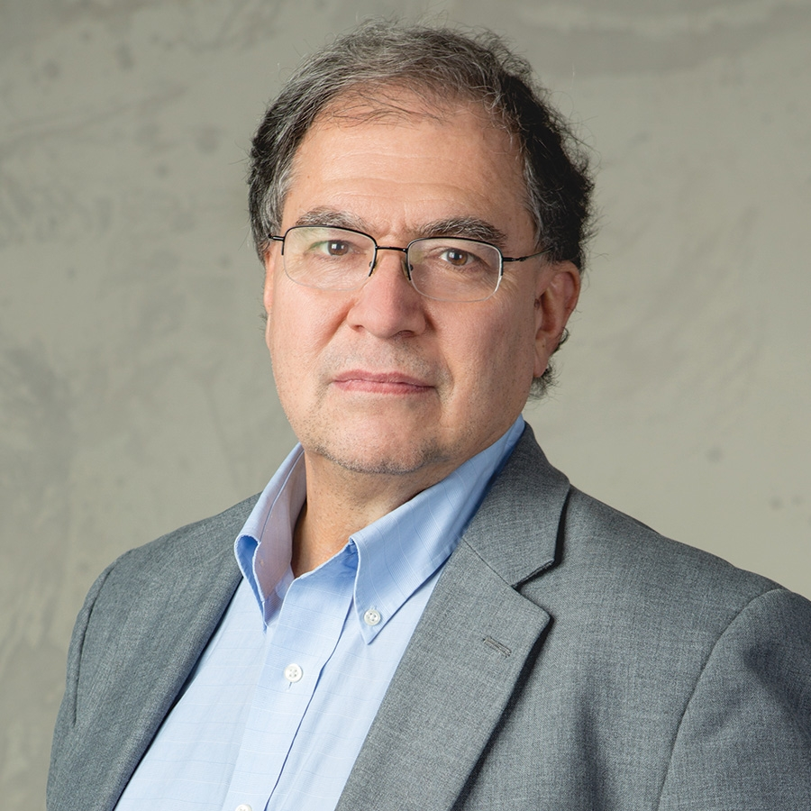
Who is Kirk Borne?
He is a widely renowned inspirational influencer, Data Scientist, Global Speaker, Consultant, Astrophysicist, and Space Scientist.
Co-creator of the field “Astroinformatics” (Data Science for Astronomy)
He has an exemplary academic record,
California Institute of Technology - M.S and Ph.D in Astronomy (1975-81)
Louisiana State University - B.S in Physics (1972-75)

Slide 3
Contributions in Data Science and Astronomy
He is currently the Principal Data Scientist , Data Science Fellow and Executive Advisor at Booz Allen Hamilton. Working there for the past 5 years.
Previously a professor of Astrophysics and Computational Science at GMU for 12 years.
Contributed to the design and development of the new Large Synoptic Survey Telescope at NASA, for which his expert knowledge in the areas of science data management, informatics, statistical science research, and galaxies research.

Slide 4
Publications and Awards
Some of his published work include
Automated Wildfire Detection through Artificial Neural Networks.
Effective Outlier Detection in Science Data Streams.
A Machine Learning Classification Broker for Petascale Mining of Large-scale Astronomy Sky Survey Databases.
Some of his Honours and Awards include:
#1 Big Data Influencer on Twitter (2013 July, November)
GMU College of Science Dean’s Annual Impact Award for Faculty Excellence - 2013
Hubble Space Telescope Individual Achievement Award (1993)
UMC Phi Kappa Phi Faculty Mentor Award (2007)

Slide 5
Our Project
The aim of our project is to forecast the sales of retail warehouse/store on a bi-hourly basis.
Short-term Forecasting
Predicting bi-hourly Sales in terms of Dollars for three weeks in the future, taking historical data of 8 months.
Insights into Sales Trends, Customer Behaviour, Impact of Holidays.
 | Focus
Sales Planning | Set Sales and Marketing resources and plan
Demand Planning | Balance Supply and Demand
Financial Planning | Long-range planning and Annual Budgeting
Distribution Center Replenishment | Stock Allocation planning
Master Scheduling | Production Planning

Slide 6
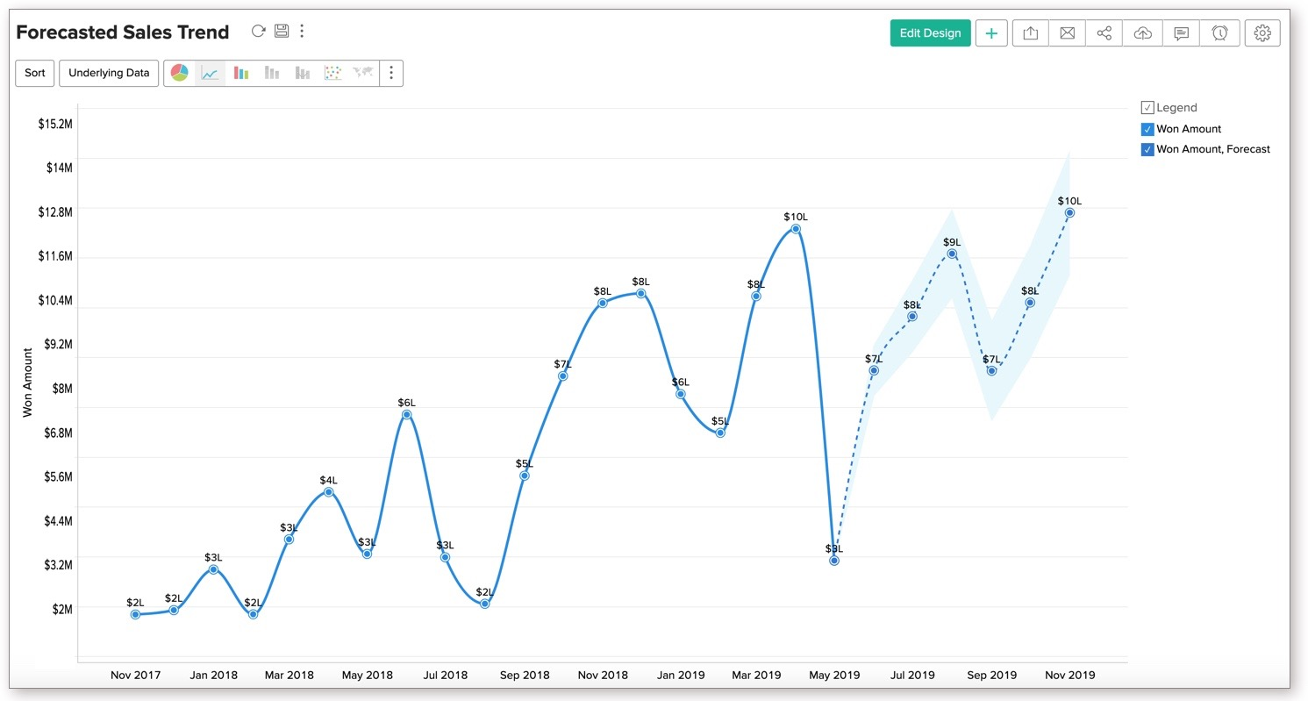

Slide 7
Project Process Map
Exploratory Data Analysis
Data Pre-Processing
Build Data Mining Models
Results
Model Evaluation

Slide 8
Understanding the data
Data comprises of
Sales between Sep 04, 2018 - Apr 14, 2019 (7 months) of a Costco store
2,046,049 rows × 20 columns
251,727 unique transactions over 7 months
$122.9 average transaction value
27,998 unique Costco members (12,386 Non- Executive + 15,612 Executive)

Slide 9
Data Descriptors
COLUMN NAME | DESCRIPTION
MBWHSE | Warehouse number
MBDATE | Date of transaction
MBMBRN | Membership Number
MBDEPT | Item sold department
MBITEM | Purchased item unique number
MBREG_NUM | Register number
MBTRN_NUM | Unique transaction number
MBTIME | Time of transaction. Ex: 2215
MBSELL | Selling price of a product
MBDSUN | Quantity of items sold
COLUMN NAME | DESCRIPTION
MBDSEL | Transaction-item amount
FISCAL_YEAR | Fiscal year of transaction
FISCAL_PERIOD | Fiscal period of transaction
IMCAT1 | Item category
IMDESC1 | Brand description of item
IMDESC2 | Description of item
IMCAT2 | Item category
IMCAT3 | Item category
CDDESC | Higher level item description
M2EXCFLG | Executive member or not

Slide 10
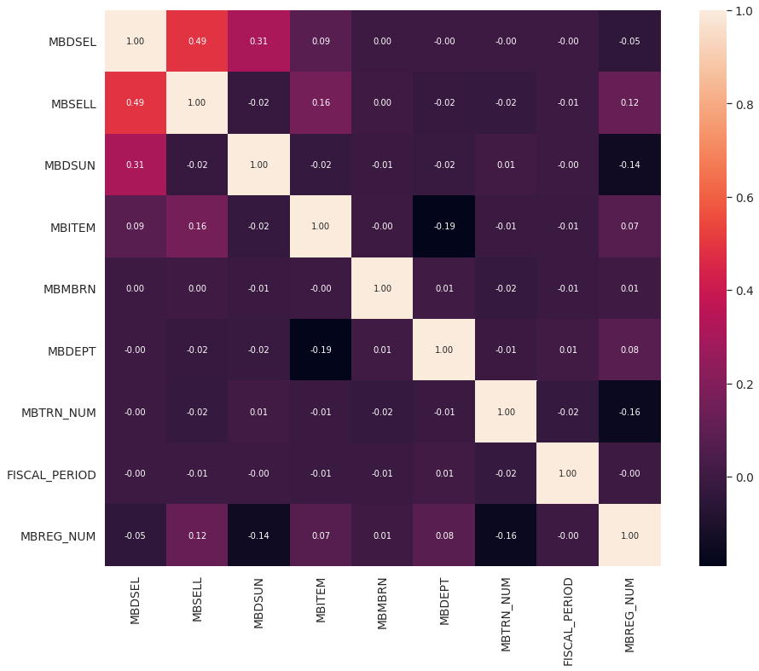
Correlation
Correlation = 0, indicates variables are independent
Correlation > 0, indicates variables are directly related
Correlation < 0, indicates variables are inversely related
Data consists of almost independent quantitative variables.

Slide 11
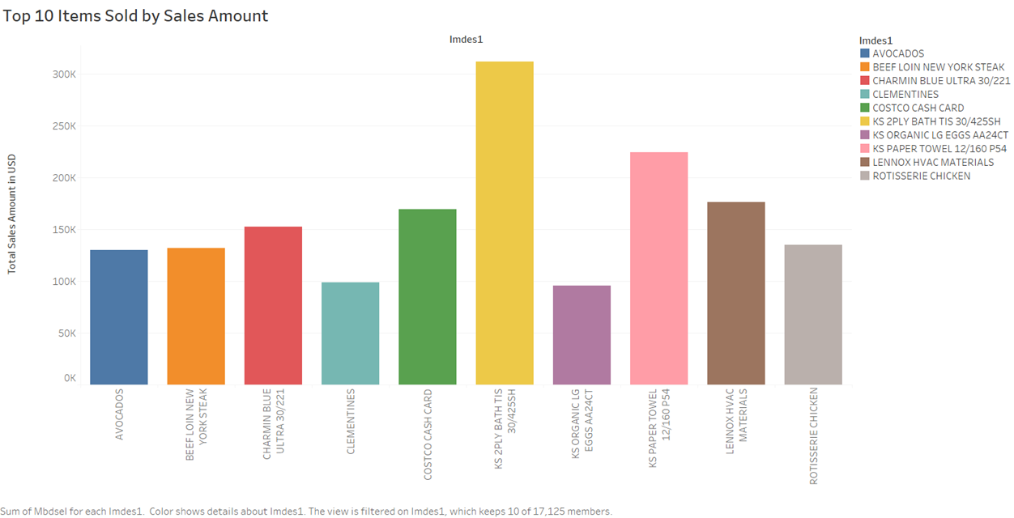
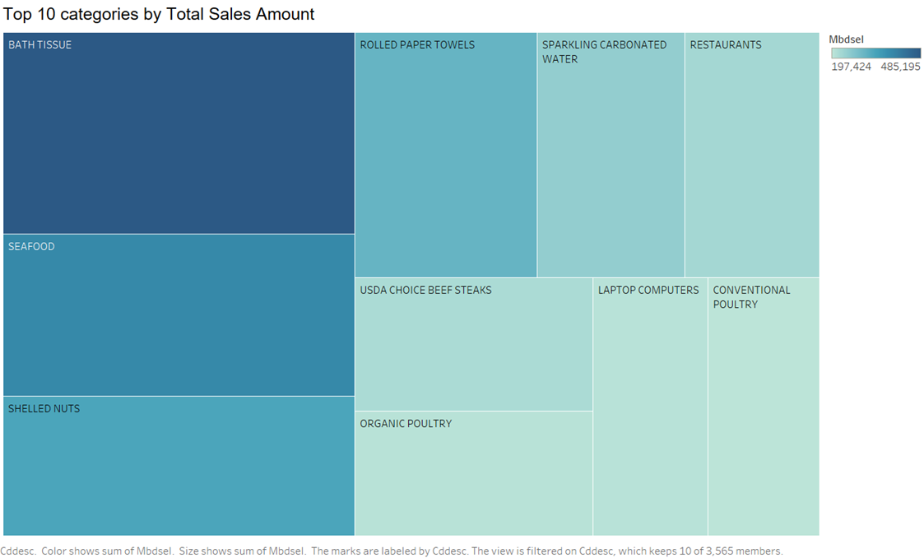
Item Sales Analysis
Bath tissue and paper towels are highest grossing products.

Slide 12
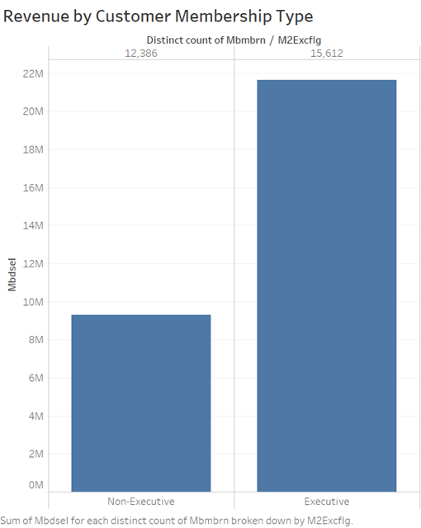
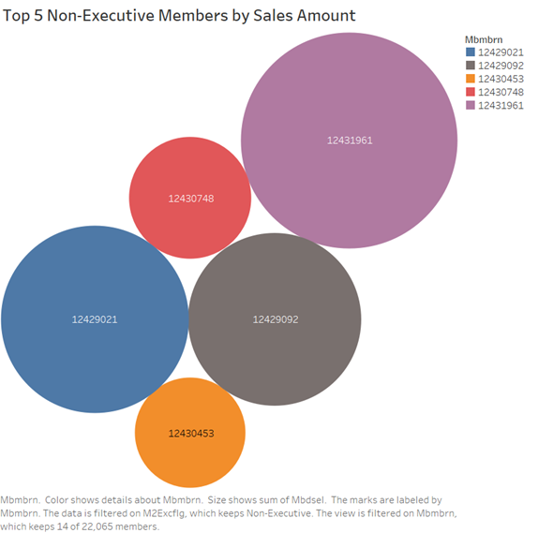
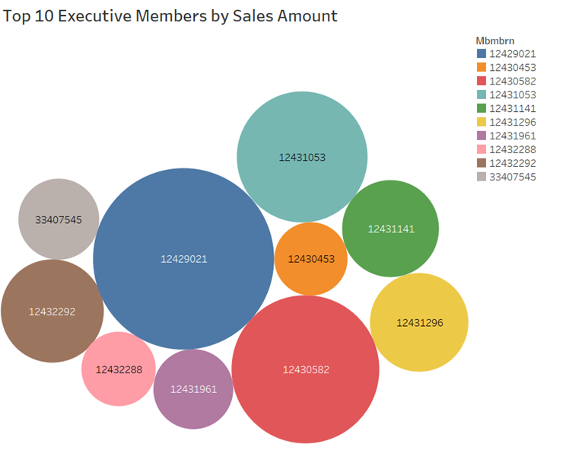
Member-Sales analysis
Average Revenue per Customer
1385
Average Revenue per Customer
751

Slide 13
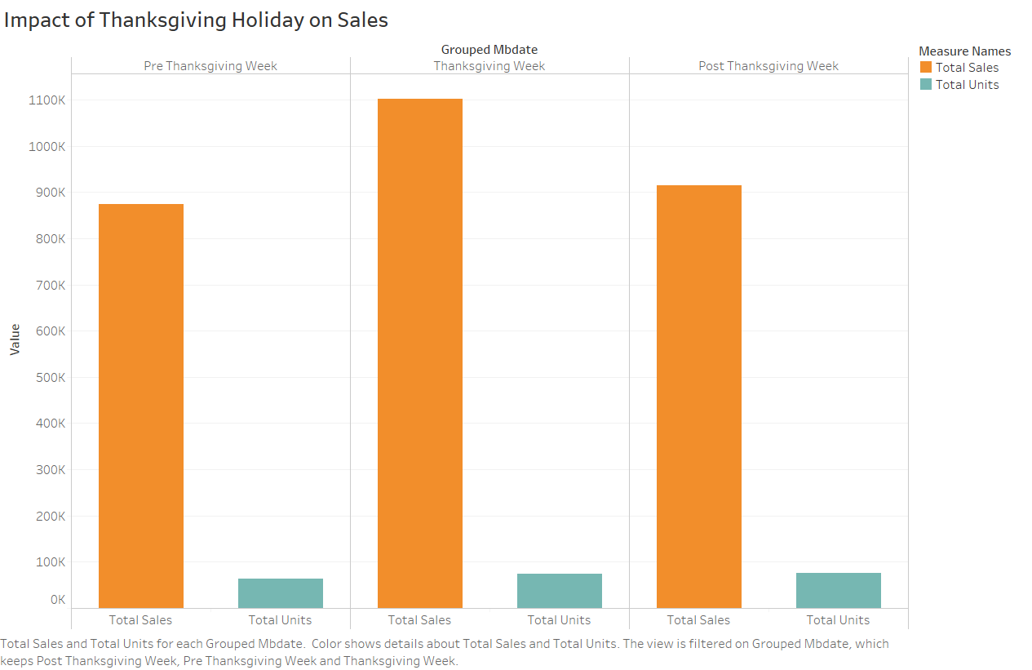
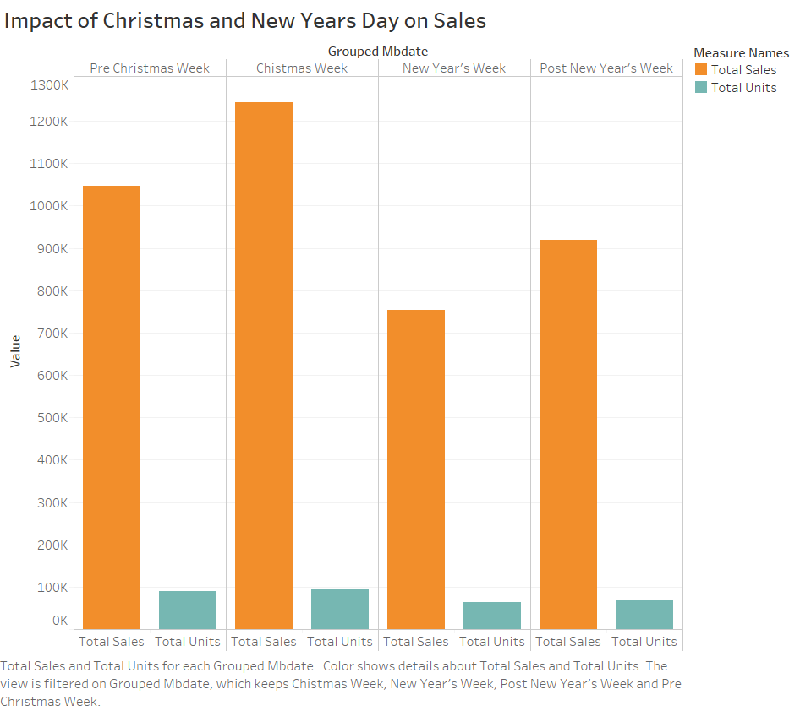
Holiday-Sales Analysis
The store was closed on 3 occasions. On Thanksgiving, Christmas and New Year’s.

Slide 14
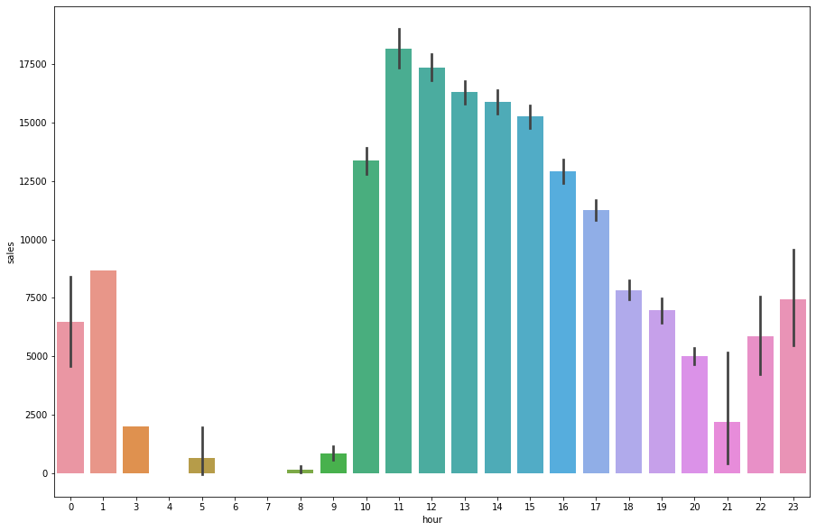
Data Preprocessing
Removed outliers by
Not considering unusual sales (identified from boxplot)
Considered sales during the store open timings. (9am - 7pm)
MBDATE and MBTIME are formatted and grouped into a datetime column
Bi-hourly sales are calculated by grouping the data by transaction time
Removed rows with Nulls and Standardized data
Summary of sales
Mean | SD | Min | 25% | 50% | 75% | Max
$15.12 | $84.7 | $13500 | $6.8 | $9.99 | $15.4 | $59890

Slide 15
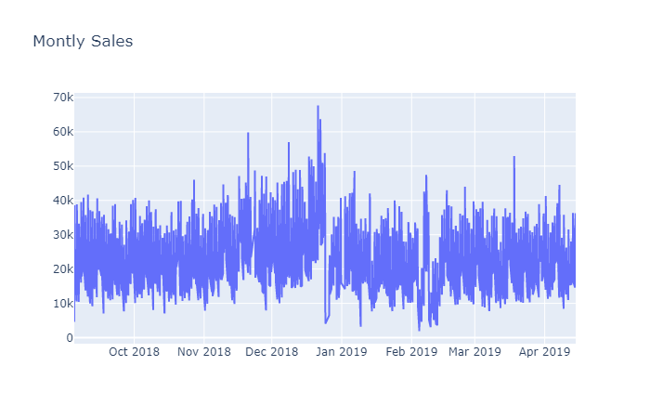
Bi-hourly sales distribution
Distributed over 7 months
On average $25,000 sales happen bi-hourly
There seems to be no seasonal trends in data

Slide 16
Time Series Through the years
1920 - 1930 : Autoregressive models and Moving Average models introduced with the work of G. U Yule and J. Walker
1970 : "Time Series Analysis" by G. E. P. Box and G. M. Jenkins, containing the full modeling procedure for individual series: specification, estimation, diagnostics and forecasting.
2008 : Support Vector Regression(SVR), Extreme Gradient Boosting(XGB) and Random Forest Regressor(RFR). Notable works include Carbonneau et al., 2008; Xingsheng Xie, 2008; Gao et al., 2009.
2008 - 2017 : Various Recurrent Neural Networks (RNN) were used to eliminate stability checking, autocorrelation function checking, thus simplifying modelling. Notable works Yunpeng et al., (2017), Muller-Navarra et al. (2015)
2017 : LSTM was used in order to persist information of previous time steps. Notable works Bandara et al. (2019); Chniti et al. (2017)

Slide 17
Data Modelling
Univariate Time Series Analysis has been used as we have modelled for one variable varying over time
The data consists of 1087 rows after pre-processing and grouping it bi-hourly.
For modelling, the data has been spilt into 847 rows for training and 240 rows for testing
Two models have been used to train the data and their performances have been compared
ARIMA - The most widely used method for time series forecasting
LSTM - Found effective due to its ability to learn from from long term dependencies

Slide 18
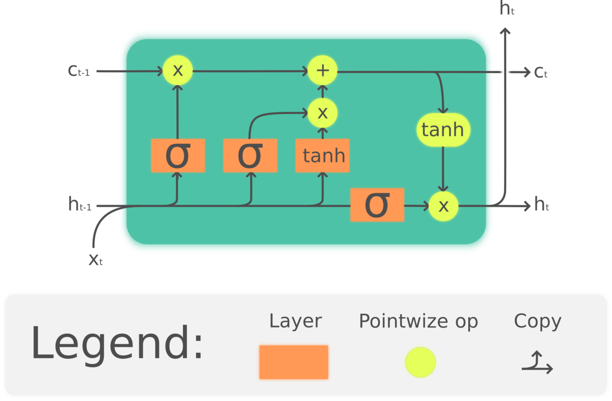
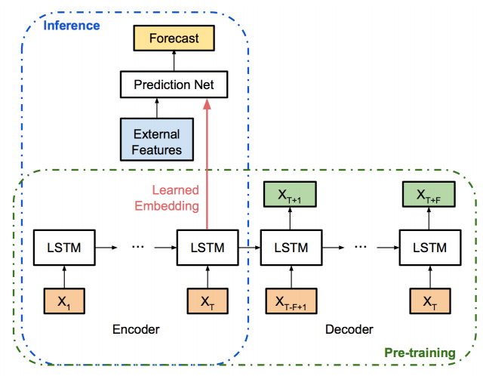
LSTM
Long Short Term Memory (LSTM) is a type of Recurrent Neural Network proposed in 1997 by Sepp Hochreiter and Jurgen Schmidhuber
LSTM unit is composed of a Cell, Input Gate, Output Gate and Forget Gate
Ability to learn long term dependencies
Hyperparameters like learning rate, number of epochs and batch size were tuned to get the optimal results

Slide 19
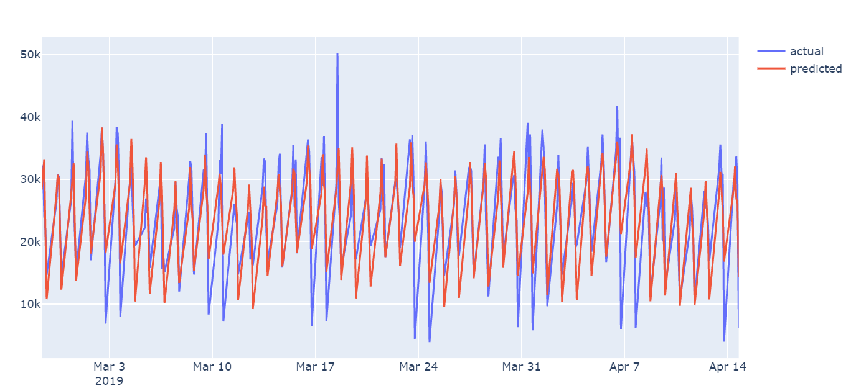
ARIMA
Auto Regressive Integrated Moving Average (ARIMA) is a generalization of an autoregressive moving average model
It is a class of models that explains a given time series based on its own past values, that is, its own lags and the lagged forecast errors.
Test for Stationary has been performed and ARIMA has been implemented

Slide 20
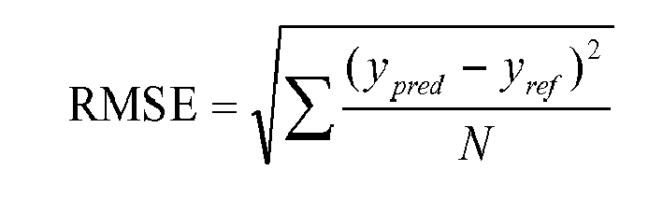

Model Evaluation
Root Mean Squared error for both models have been computed and compared
LSTM : 576.89
ARIMA: 6277.05
Accuracy of the models is calculated based on the Mean Absolute Percentage Error
LSTM : 0.0236
ARIMA : 0.198
The best model is found to be LSTM, which produces lower RMSE and lower MAPE (better accuracy) compared to ARIMA.

Slide 21
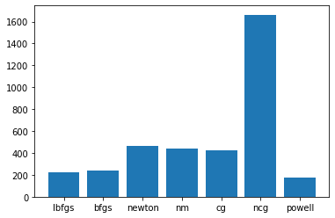
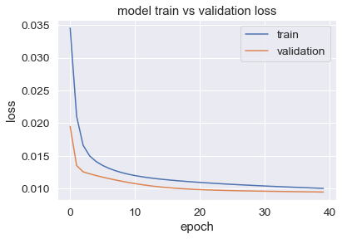
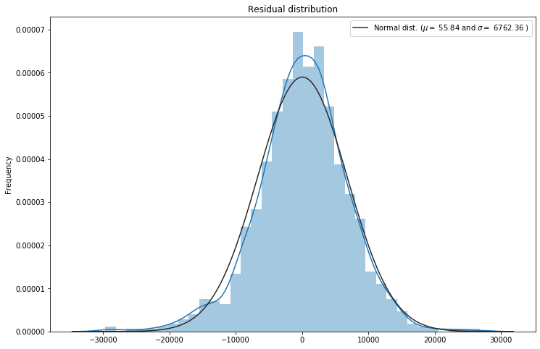
Model Evaluation
ARIMA
LSTM

Slide 22
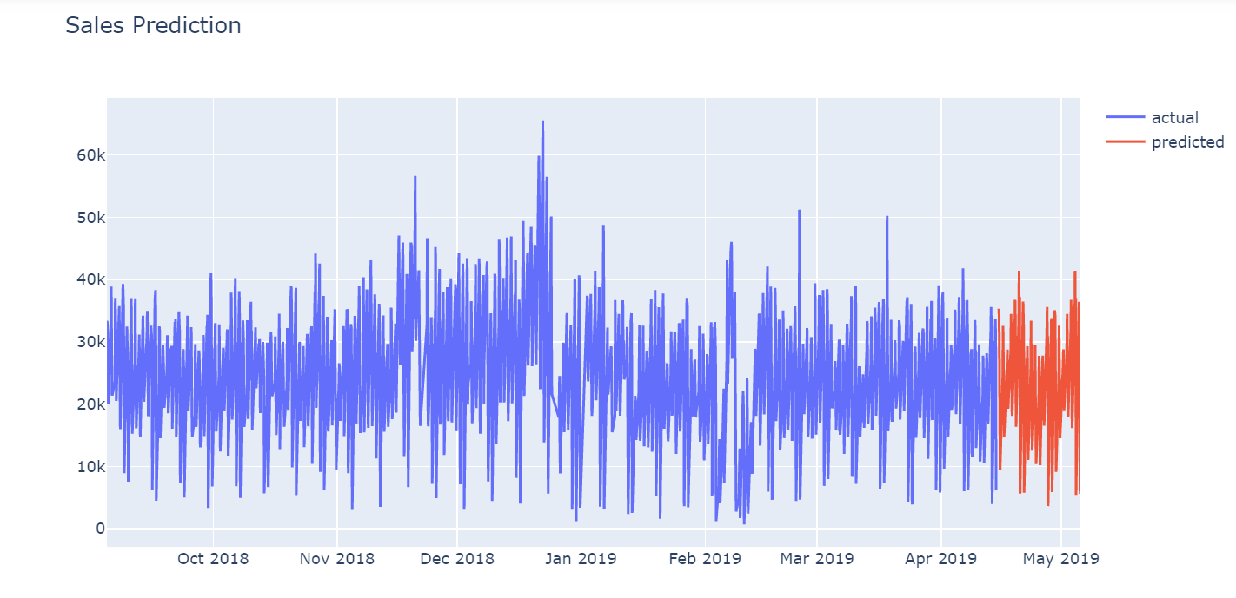
Conclusion
Sales Planning
Business can set sales targets
Resource management
Helps in allocation of resources and products stocking
Presenting to investors
Measurement of company's health
Product Recommendations
Derived association rules to describe customer behavior towards different categories

Slide 23
Future work
Hyperparameters tuning can be automated using Bayesian Optimization
Sales Forecasting can be extended to more warehouses and results can be compared
Sales of individual products can be forecasted and used for demand planning
Impact of external factors like weather and demographics can be included in the forecasting model
Customer analysis can be performed and buying patterns can be analysed with appropriate data
To include sales projection in terms of volume, which helps in demand planning as well as depot allocation.

Slide 24
THANK YOU
“Without big data analytics, companies are blind and deaf, wandering out onto the web like deer on a freeway.”
– Geoffrey Moore, author and consultant.

